Slide 1
HOME AUTOMATION & SMART SECURITY
(Digital System Design)
USING ARDUINO

Slide 2
Youtube Video Link
https://www.youtube.com/watch?v=RRzYGr7-yb8

Slide 3
INTRODUCTION
There is an increasing demand for smart homes, where appliances can be easily controlled through one common device.
Home automation system (HAS) involves introducing a degree of automatic control to certain electrical and electronics system.
The client modules(lights, Fans, Ac, other peripheral devices) communicate with host controllers through a wireless device such as a Bluetooth enabled mobile phone, in this case, an android based smart phone.

Slide 4
MAIN IDEA
The basic ideas will be-
Fingerprint Lock for Door
Control with Android App
App controlled On & OFF switch (Lights, Fans, other peripheral devices) that is going to operate wirelessly via Bluetooth.
Security Alarm if it detects
Fire
Smoke
Gas
Air Pollution

Slide 5
MOTIVATION
Must needed security due to Increasing number of crimes such as thefts, robbery.
No need to carry the keys to open the lock
Numerous fire events due to carelessness
Find a way to bring comfort
Save Electricity and Electricity bill

Slide 6
COMPONENTS REQUIRED
Arduino UNO
Relay Board
Servo motor
Buzzer
Breadboard
Jumper Wires
LED Bulbs
Dc motor
Battery
Resistor (1k, 2K ohm)
Light Sensor or Motion Sensor
Flame Detect Sensor
MQ-02 (Gas Sensor)
MQ-7 (Sensitive for Carbon Monoxide)
MQ-135 (For Air Quality)
Fingerprint Sensor

Slide 7
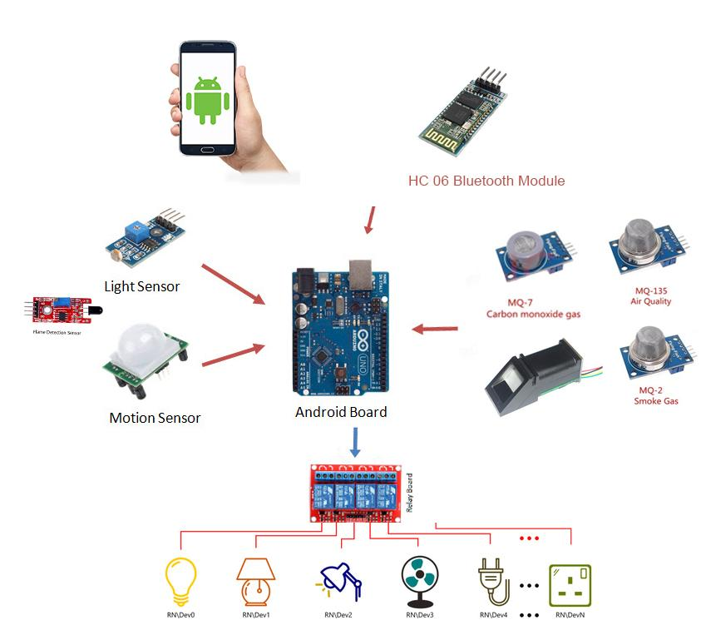
PROPOSED METHODOLOGY

Slide 8
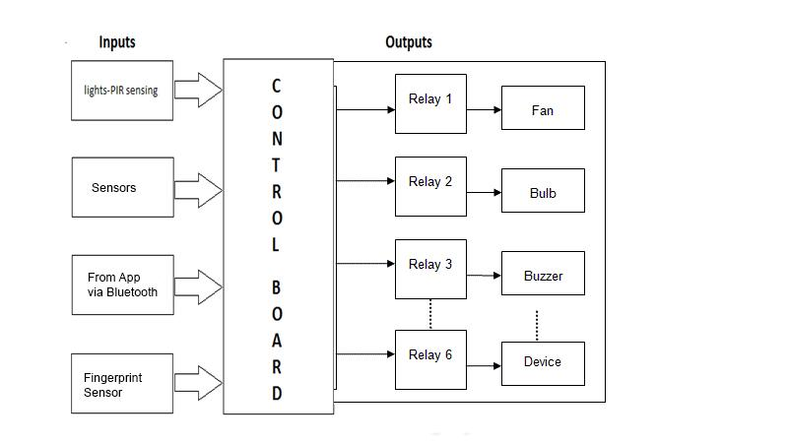
PROPOSED METHODOLOGY

Slide 9
PROPOSED METHODOLOGY
Detect & Alarm: It will take input from different sensors show Alarm
Smart Lock: Fingerprint sensor for door lock
Control: Bulbs, Fans will turn on and off using app, also check status
on or off

Slide 10
A NEW BEGINNING
Save electricity
Add Comfort in our daily life
Most importantly Smart Security
Cheap and Convenient.

